Slide 1
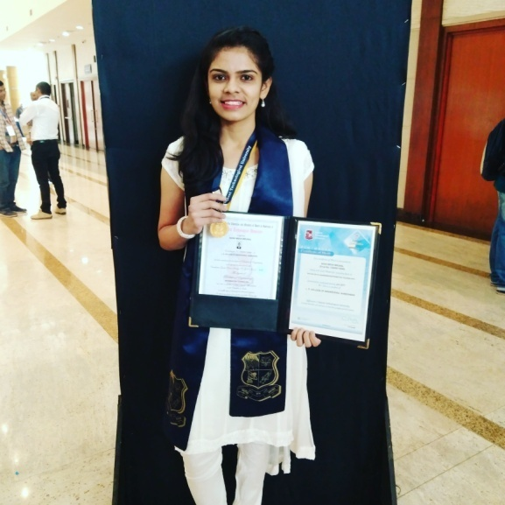
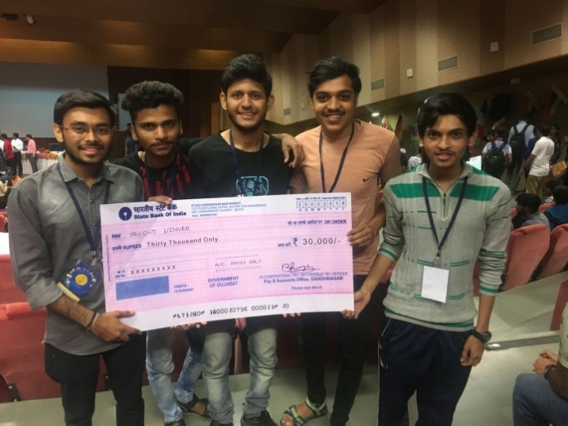
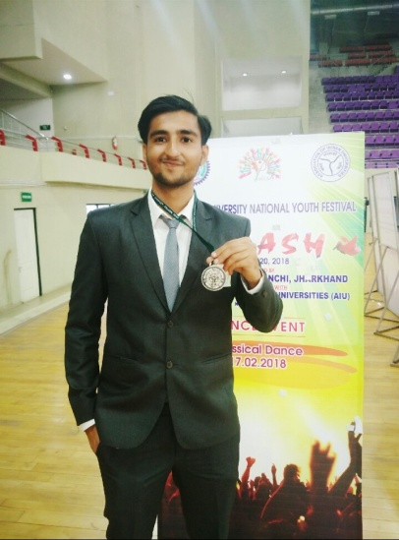
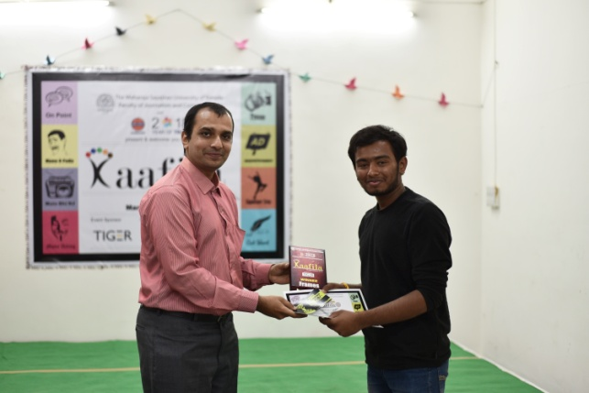
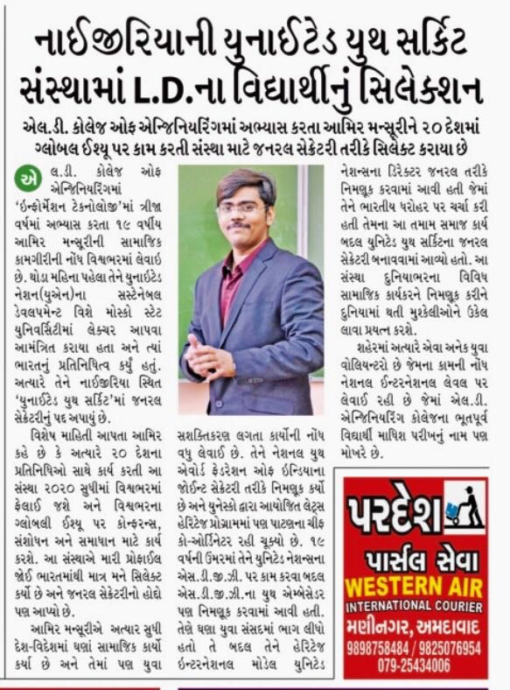
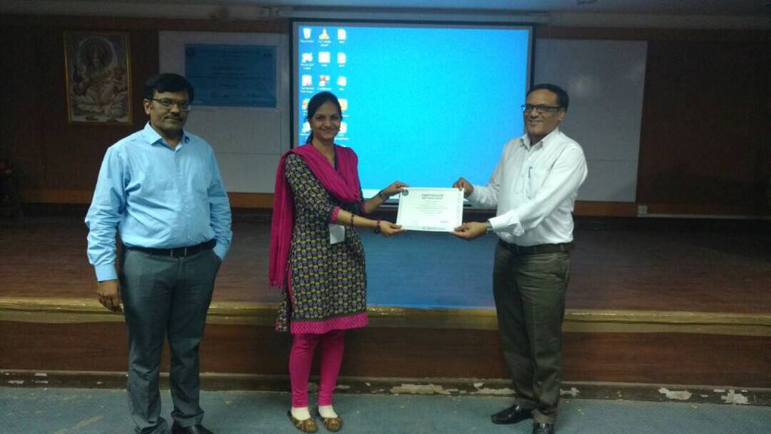
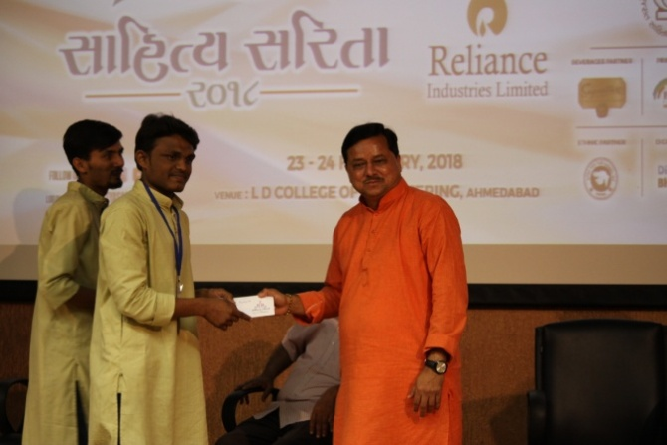
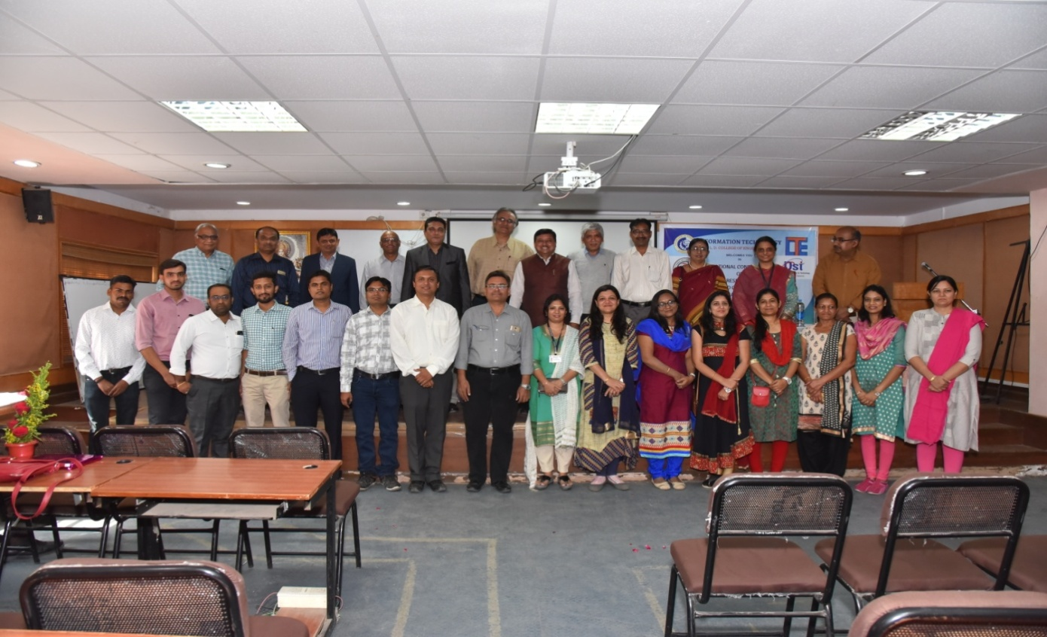
 | Meha Shah has secured Gold Medal in Bachelors of Engineering in Information Technology Branch on 12th January 2018 by Gujarat Technological University.
 | Darshan Hansora and Ajay Kothiya, 6th semester students got 2nd rank and won prize worth Rs.30000 as a team member in Final Round of Smart Gujarat for New Heckathon on 25th March 2018.
 | Yashrajsinh Dodiya, 8th Semester student represented LD College, GTU and Gujarat at National youth festival held at Ranchi and came in top 5 in country in Quizzing. He also won quiz at inter college youth festival at St Xavier’s and won Ahmedabad heritage quiz held in LD College of engineering.
 | Trivedi Swapnil, 8th Semester student won 1st Prize in Photography Competition (FRAME) held at MSU Faculty of Journalism and Communication in KAAFILA2018 on 17-18 March 2018. He also won 3rd prize In HCG Hospital Event HERITOCLICK on 4-12 Feb 2018.
 | Two teams from 6th Semester students were selected for Smart India Heckathon 2018. Aamir Mansuri, 6th semester student selected as a General Secretary in “UNITED YOUTH CIRCUIT” situated at Nigeria.
 | Hiral Patel, ME 2nd year student got Best Paper Award in National Conference on “Advances in Computer Science Engineering & Technology” organized by CE department at LDCE for the paper “Serendipitous Bookmark Recommendation in a social bookmarking system using Behavioural Data Mining” on 6th May, 2017.
 | Nitesh Solanki, 6th semester student developed NSS LDCE website which is hosted by Education minister Bhupendrasinh Chudasama at LDCE. He also got best event manager award by principle sir of L.D. college of Engineering in Sahitya Sarita 2018 held on 23-24 Feb 2018.
Mevada Moksha and Solanki Nitesh, 6th semester students participated in GIRLS SCRIPT HACKATHON in Girl script India Summit, organized at Silver Oak College on 16th December 2017. Moksha and team were the complementary winners of the event.
 |  | Information Technology Department has successfully organized National Conference on “Advance Research Trends in Information and Computing Technology” on 20/01/18.

